Slide 1

BASICIS OF CIVIL ENGINEERING & MECHANICS
Course code:CV14/CV24
Credits:3:0:0
Topics Covered
New Marginal and Smart Materials

Slide 2

New AGE & Marginal: Definition, variety, Applications
DEPARTMENT OF
CIVIL ENGINEERING
Course: Basics of Civil Engineering & Mechanics
Credits: 3:0:0
New Age Construction Materials
Innovative materials are emerging in the construction Industry that is revolutionizing and gaining momentum to have developments in concrete and other construction materials.

Slide 3
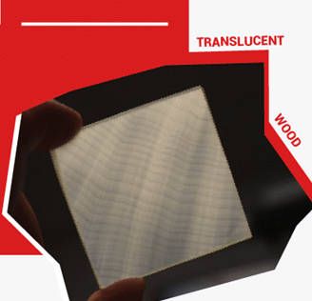
Translucent wood
DEPARTMENT OF
CIVIL ENGINEERING
Course: Basics of Civil Engineering & Mechanics
Credits: 3:0:0
We now have translucent wood that can be used to develop windows and solar panels. It is created by first, removing the lining in the wood veneer and then through nanoscale tailoring. The resulting effect creates translucent wood that has various applications in the construction industry.

Slide 4

The cooling system in bricks
DEPARTMENT OF
CIVIL ENGINEERING
Course: Basics of Civil Engineering & Mechanics
Credits: 3:0:0
A research conducted by Advanced architecture of Catalonia has developed building material that cools the building interior by absorbing water up to 500 times of its weight in the presence of hydro gel in its structure. Hydro ceramics has the ability to reduce indoor temperature by 6 degree.

Slide 5

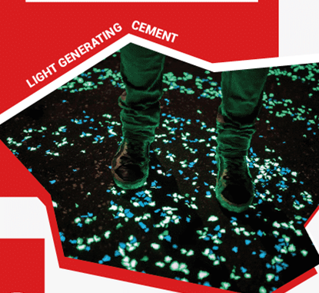
Martian concrete
DEPARTMENT OF
CIVIL ENGINEERING
Course: Basics of Civil Engineering & Mechanics
Credits: 3:0:0
Researchers at north western University have developed concrete that can be made from materials available at Mars. In order to make Martian concrete sulphur is heated to 240degree Celsius which melts it into liquid.
Light-generating cement:
Dr Jose Carlos Rubio Avalos from UMSNH of Morelia has developed cement that has the ability to absorb and radiate light and has immense application as cement can be developed at room temperature. The science behind it: Through the process of polycondensation of raw materials such as river sand, industrial waste, silica, water, and alkali. The process is done at room temperature which is why the energy usage is low.

Slide 6
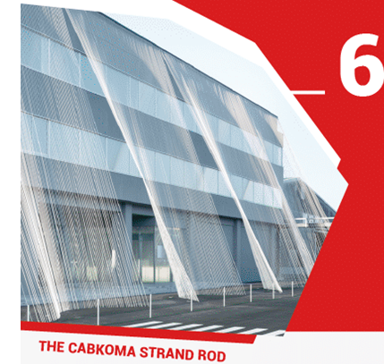
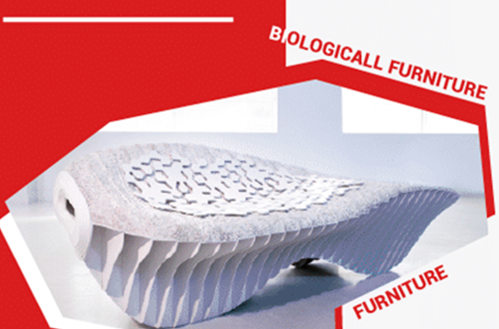
The CABKOMA strand rod
DEPARTMENT OF
CIVIL ENGINEERING
Course: Basics of Civil Engineering & Mechanics
Credits: 3:0:0
The Komatsu Seiten fabric Laboratory based in Japan has created a new material called CARBKOMA Strand that is therrmo plastic carbon fiber composite that is lightest seismic reinforcement weighing 12kg for a length of 160 m which is 5 times lighter than metal rod.
Biologically produced furniture
Bio plastic furniture are developed for kids furniture using low energy process. The furniture is made by a material called Mycoform, which is made by combining wood chips, gypsum, and oat bran together with a fungus called Ganoderma lucidum. This fungus is added as it has the ability to disintegrate waste products and leave a strong structural material.

Slide 7

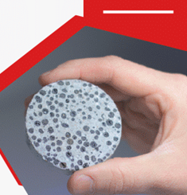
Cigarette butts to make bricks:
DEPARTMENT OF
CIVIL ENGINEERING
Course: Basics of Civil Engineering & Mechanics
Credits: 3:0:0
Elements such as arsenic, chromium, nickel enter the soil to have a harmful impact on the environment. About 6 million cigarettes are manufactured developing about 1.2 million tons of cigarette butt waste. In order to reduce the effect of cigarette butts on the environment researchers at RMIT have developed lighter and more energy efficient bricks.
Self-healing concrete
Self healing concrete was developed by Dr Schlangen from Delft University by breaking material into two and putting the material together and heating the concrete in microwave oven, once the melted material cools down joins together.

Slide 8

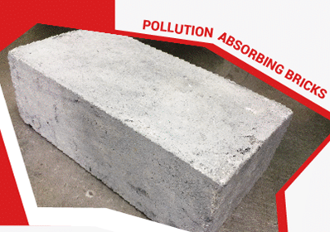
Floating piers
DEPARTMENT OF
CIVIL ENGINEERING
Course: Basics of Civil Engineering & Mechanics
Credits: 3:0:0
Floating piers are created by artists Christo and Jean- Claude over the water of Italy’s lake Iseo. It is about 3 kilometer long walk way with 100, 000 square meters of floating docking system made of polyethylene cubes of high density.
Pollution Absorbing bricks
Pollution absorbing bricks sucks in pollutants in air and releases filtered air consisting of two layer of façade system with specialist bricks on the outside and standard insulation on inside. From the wind tunnel tests conducted it is proven that the system can filter about 30% of fine particle pollutants and 100% of coarser particles such as dust.

Slide 9
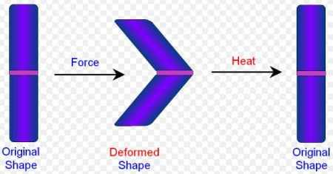
Smart materials usage in Civil Engineering and their application
DEPARTMENT OF
CIVIL ENGINEERING
Course: Basics of Civil Engineering & Mechanics
Credits: 3:0:0

Slide 10
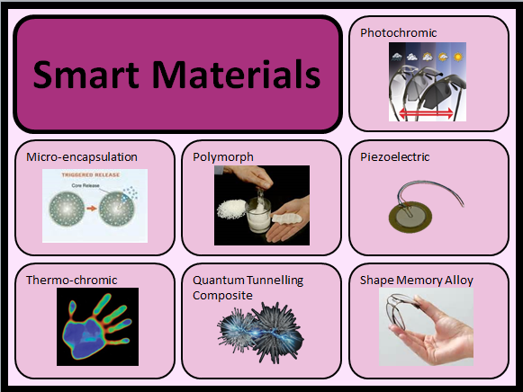
DEPARTMENT OF
CIVIL ENGINEERING
Course: Basics of Civil Engineering & Mechanics
Credits: 3:0:0
Smart Materials:
Smart materials have different properties that are affected by the external factors such as temperature, light, stress, electric and magnetic fields. They are also known as intelligent responsive materials. Smart materials are use in various civil engineering projects to increase their performance and efficiency of the structure.

Slide 11
DEPARTMENT OF
CIVIL ENGINEERING
Course: Basics of Civil Engineering & Mechanics
Credits: 3:0:0
Types of Smart materials:
Electro chromic Materials: These smart materials alter the light transmission properties when voltage is applied to them. They affect the optical color of a surface when voltage is applied to them and are known as chromo-phones.
Electro rheological Fluids: These smart materials present in the colloidal suspension undergo changes in viscosity when subjected to electric field. These materials highly sensitive and responds to the any change in the applied electric field and are used as shock absorbers.
Piezoelectric Materials: In these smart materials undergoes deformation when an electric field is applied in response to magnetic field. These materials produce voltage when surface strain is introduced.
Magnetostrictive Materials: These smart materials undergo mechanical deformation that is proportional to the square of the electric field. These materials produce voltage when stretched in response to magnetic field.
Shape Memory Alloys: These smart materials have the ability to regain previously define shape or size when subjected to thermal changes. These materials are used in Civil Engineering projects to absorb strain energy without permanent deformation, for resisting particularly cyclic and fatigue behavior and structures to be utilized durably in the long run.

Slide 12
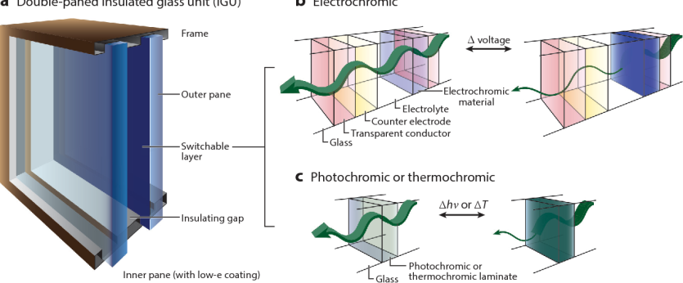
DEPARTMENT OF
CIVIL ENGINEERING
Course: Basics of Civil Engineering & Mechanics
Credits: 3:0:0
Electro chromic Materials

Slide 13
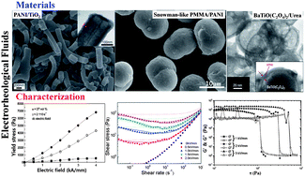
DEPARTMENT OF
CIVIL ENGINEERING
Course: Basics of Civil Engineering & Mechanics
Credits: 3:0:0
Electro rheological Fluids:

Slide 14
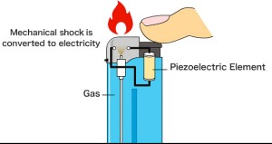
DEPARTMENT OF
CIVIL ENGINEERING
Course: Basics of Civil Engineering & Mechanics
Credits: 3:0:0
Piezoelectric Materials:

Slide 15
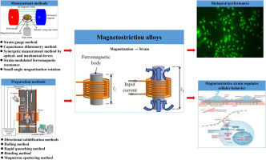
DEPARTMENT OF
CIVIL ENGINEERING
Course: Basics of Civil Engineering & Mechanics
Credits: 3:0:0
Magnetostrictive Materials:

Slide 16
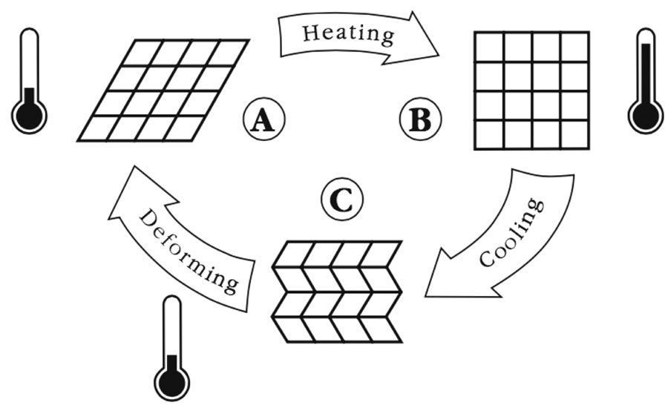
DEPARTMENT OF
CIVIL ENGINEERING
Course: Basics of Civil Engineering & Mechanics
Credits: 3:0:0
Shape Memory Alloys:

Slide 17
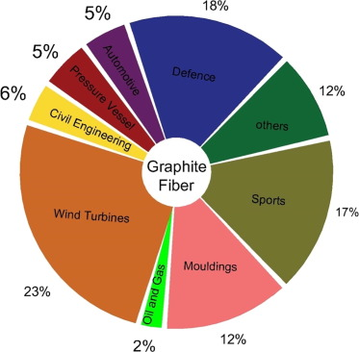
DEPARTMENT OF
CIVIL ENGINEERING
Course: Basics of Civil Engineering & Mechanics
Credits: 3:0:0
Applications of Smart materials

Slide 18
DEPARTMENT OF
CIVIL ENGINEERING
Course: Basics of Civil Engineering & Mechanics
Credits: 3:0:0
Applications of Smart materials
Smart Materials are used in constructing smart structures and which are capable of sensing minute structural cracks and flaws.
Smart Materials can be used for electromagnetic shielding and for enhancing electrical conductivity.
Smart Materials plays a vital role in the construction of road pavements as a traffic-sensing recorder, and also melts ice on highway and airfields during snowfall in the winter season bypassing the low voltage current through it.
Smart Materials are used in the designs of Smart buildings. They are used for vibration control, noise mitigation, safety and performance.
Smart Materials are used in smart buildings for environmental control, structural health monitoring.
Smart Materials are used to transform efficiency, comfort and safety for people and assets in smart buildings.
Smart materials also reduce the effects of earthquakes.
Smart Materials are used in marine and rail transport applications for strain monitoring using embedded fibre optic sensors.

Slide 19
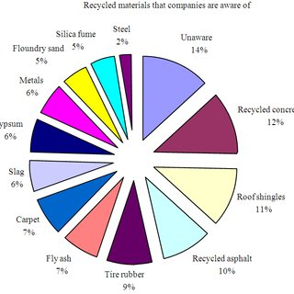
DEPARTMENT OF
CIVIL ENGINEERING
Course: Basics of Civil Engineering & Mechanics
Credits: 3:0:0
Recycling of materials: Types of materials that can be recycled

Slide 20

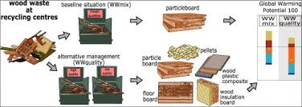
DEPARTMENT OF
CIVIL ENGINEERING
Course: Basics of Civil Engineering & Mechanics
Credits: 3:0:0
Recycling- wood
Recycling- Glass

Slide 21
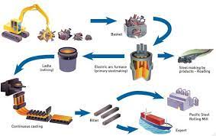
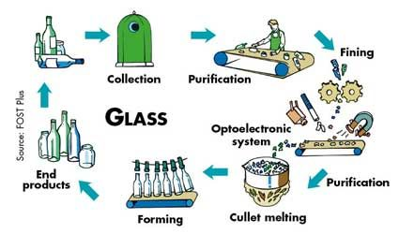
DEPARTMENT OF
CIVIL ENGINEERING
Course: Basics of Civil Engineering & Mechanics
Credits: 3:0:0
Recycling- Metal
Recycling-Glass

Slide 22

DEPARTMENT OF
CIVIL ENGINEERING
Course: Basics of Civil Engineering & Mechanics
Credits: 3:0:0
Recycling -Plastic
Recycling -Metal

Slide 23
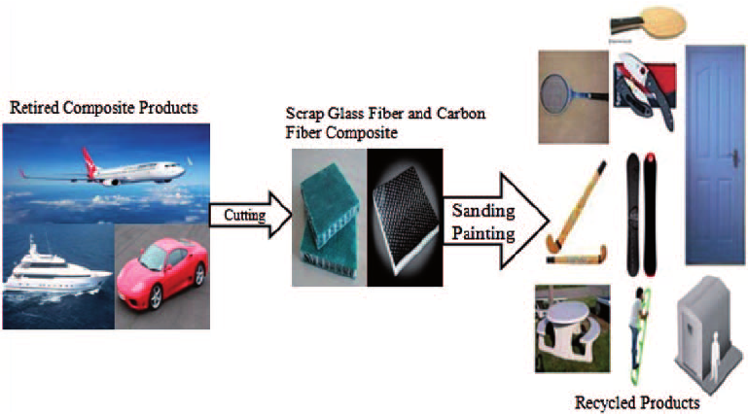
DEPARTMENT OF
CIVIL ENGINEERING
Course: Basics of Civil Engineering & Mechanics
Credits: 3:0:0
Recycling of materials

Slide 24
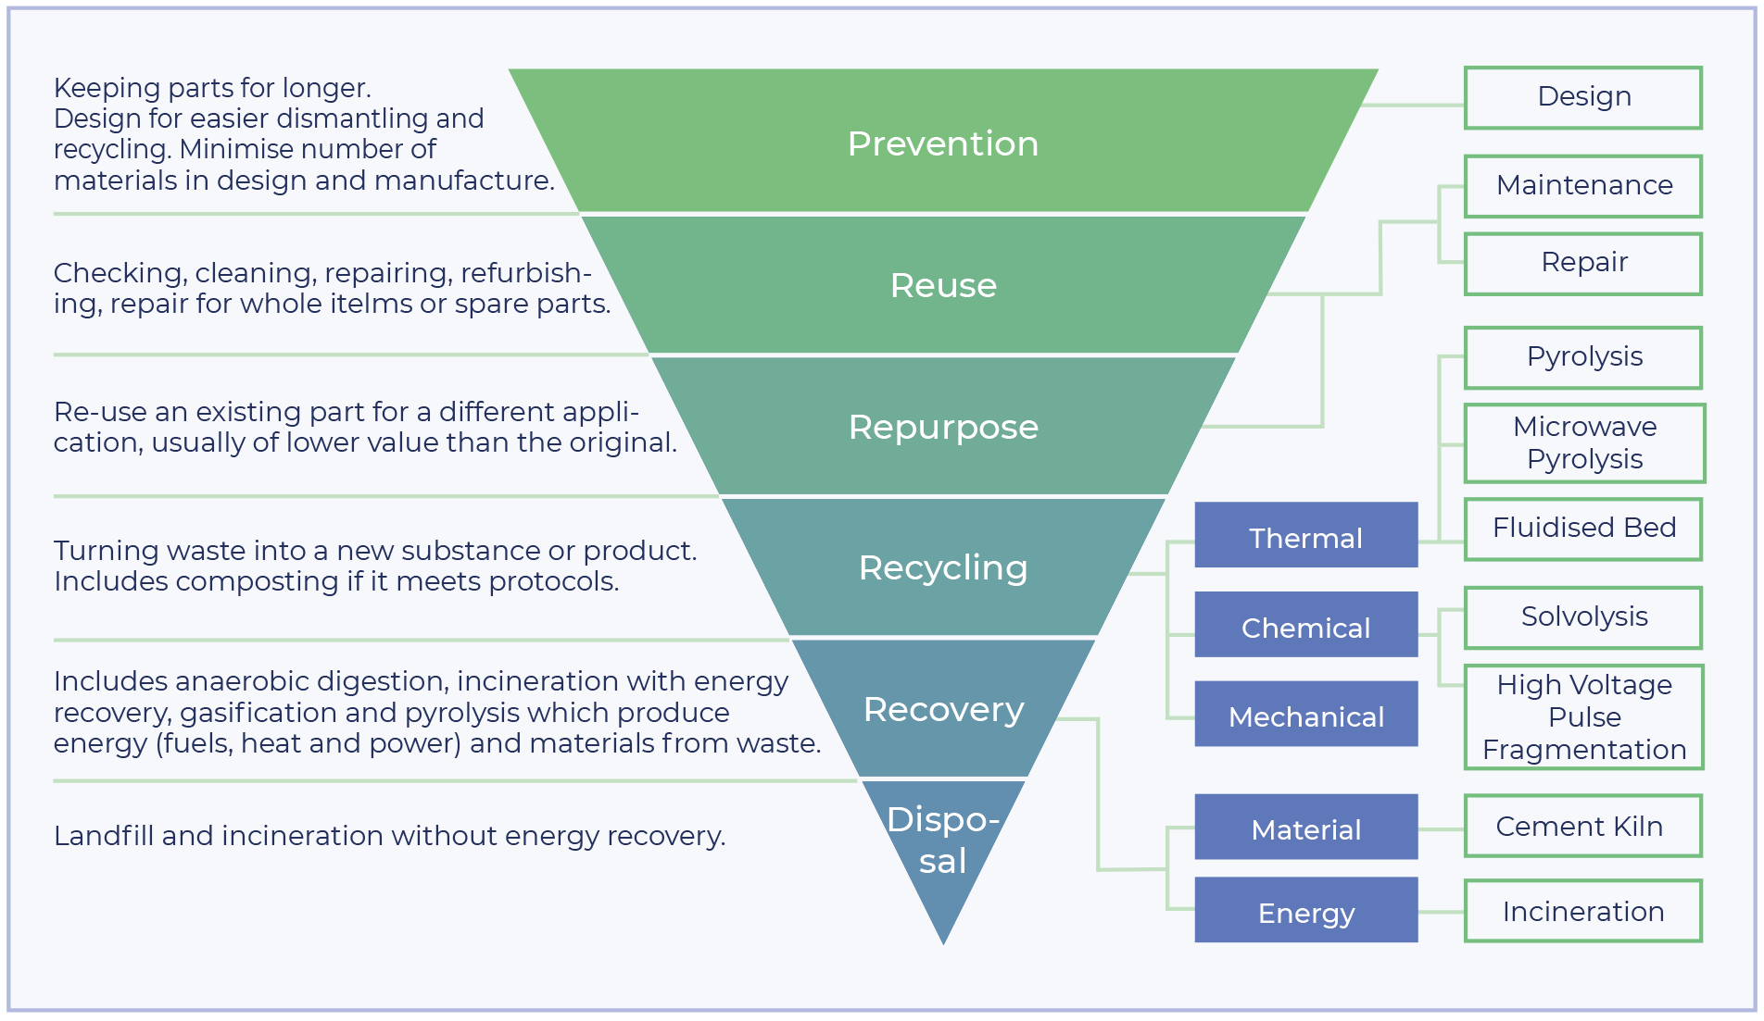
DEPARTMENT OF
CIVIL ENGINEERING
Course: Basics of Civil Engineering & Mechanics
Credits: 3:0:0
Recycling of materials

Slide 25
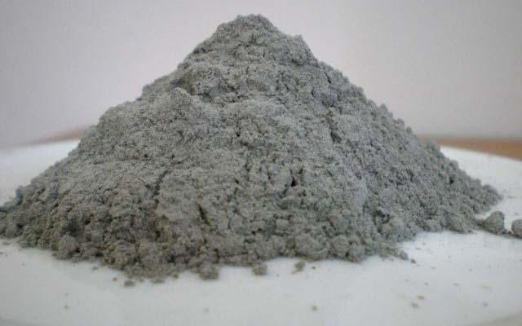
DEPARTMENT OF
CIVIL ENGINEERING
Course: Basics of Civil Engineering & Mechanics
Credits: 3:0:0
FLYASH:
Fly ash is finely divided residue resulting from the combustion of powdered coal and transported by the flue gases and collected by;
Electrostatic
Precipitator
Fly ash is the most widely used pozzolanic material all over the world.

Slide 26
DEPARTMENT OF
CIVIL ENGINEERING
Course: Basics of Civil Engineering & Mechanics
Credits: 3:0:0
Ingredients / composition of Flyash
Component | Bituminous | Subbituminous | Lignite
SiO₂ (%) | 20-60 | 40-60 | 15-45
Al₂O₃ (%) | 5-35 | 20-30 | 20-25
Fe₂O₃ (%) | 10-40 | 4-10 | 4-15
CaO (%) | 1-12 | 5-30 | 15-40
LOI (%) | 0-15 | 0-3 | 0-5

Slide 27
DEPARTMENT OF
CIVIL ENGINEERING
Course: Basics of Civil Engineering & Mechanics
Credits: 3:0:0
Advantages of using Fly ash
Increases ultimate concrete strength and durability
Is more economical than portland cement
Reduces the heat of hydration (first used in mass concrete construction in the building of Hungry Horse Dam, Montana,1948)
Reduces risk of alkali-silica reaction (ASR)
Increases resistance to sulfate attack
Reduces concrete bleeding (water loss at the surface after placement) Reduces concrete shrinkage during curing
Reduces the amount of water required in mixtures
Reduces permeability (increases concrete’s resistance to water penetration)
Improves workability (microscopic, spherical-shaped particles create a more flowable, easier-to-finish concrete)
Lightens the color of concrete
Fulfills LEED points (LEED MR 4.1, Reclaimed Materials/Recycled Content) and is routinely specified on many green projects

Slide 28
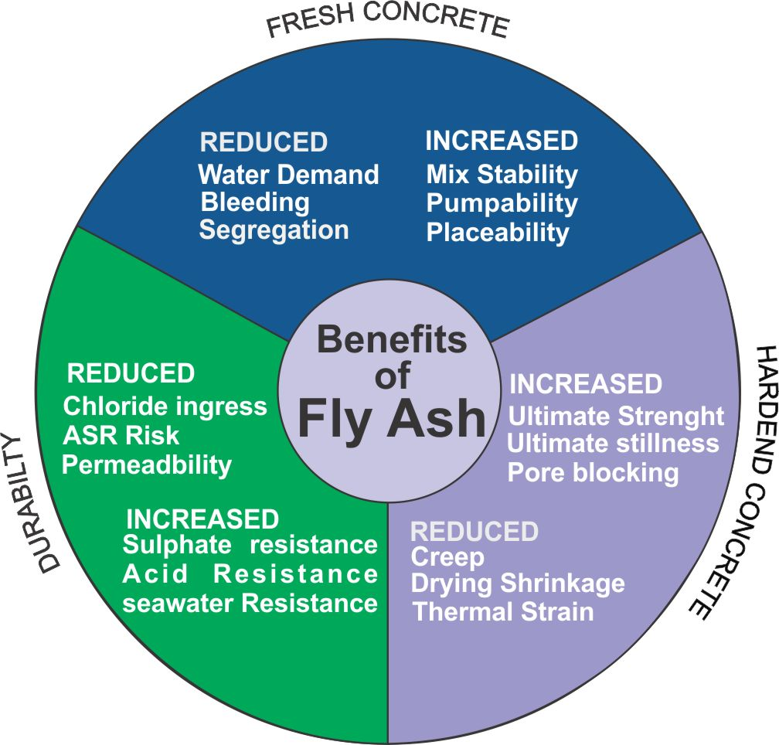
DEPARTMENT OF
CIVIL ENGINEERING
Course: Basics of Civil Engineering & Mechanics
Credits: 3:0:0
Advantages of Using Flyash

Slide 29
DEPARTMENT OF
CIVIL ENGINEERING
Course: Basics of Civil Engineering & Mechanics
Credits: 3:0:0
Application of using Flyash
Many high-rise buildings
Industrial structures
Water front structures
Concrete roads
Roller compacted concrete dams.

Slide 30

DEPARTMENT OF
CIVIL ENGINEERING
Course: Basics of Civil Engineering & Mechanics
Credits: 3:0:0
References
Marginal materials References: Dr. Quentin L. Robnett, “Use of Marginal Materials in Highway Construction”, School of Civil Engineering Georgia Institute of Technology Atlanta, Georgia

Slide 31
Application of smart and sustainable materials in Civil Engineering constructions .
DEPARTMENT OF
CIVIL ENGINEERING
Course: Basics of Civil Engineering & Mechanics
Credits: 3:0:0

Slide 32
DEPARTMENT OF
CIVIL ENGINEERING
Course: Basics of Civil Engineering & Mechanics
Credits: 3:0:0
Introduction
Smart materials are the materials which have the ability to respond to changes in their condition or the environment to which they are exposed, in a useful and usually repetitive manner. Structures that incorporate smart materials are called as “Smart Structures”. Smart materials are developed which responds to environmental stimuli such as pressure, temperature and wind.
Smart materials used in construction technology includes self healing coatings, smart concrete, shape shifting metals, transparent metals, aerogels etc., which will change the construction technology in near future.

Slide 33
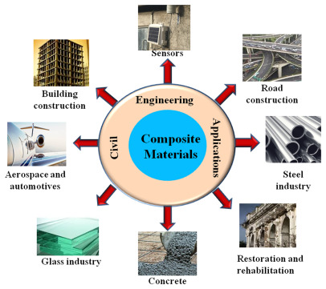
DEPARTMENT OF
CIVIL ENGINEERING
Course: Basics of Civil Engineering & Mechanics
Credits: 3:0:0
Smart materials are actually compositely designed materials having one or more properties significantly changeable in a controlled fashion by application of external stimuli or inputs. The inputs are mostly in the form of mechanical stress/ strain, change in temperature, pH, light or moisture, induction of electric or magnetic fields, light, or chemical compounds. Having such properties, they are rightly also called as intelligent or responsive materials.

Slide 34
DEPARTMENT OF
CIVIL ENGINEERING
Course: Basics of Civil Engineering & Mechanics
Credits: 3:0:0
Types of Smart Construction Materials
Shape Memory Alloys (SMAs)
Such materials possess the ability to regain to some previously defined shape or size when subjected to appropriate thermal changes. Shape memory alloys find their applications in new applications in civil engineering specifically in seismic protection of buildings.
The application of shape memory alloy in civil engineering application, are- repeated absorption of strain energy without permanent deformation, for obtaining wide range of cyclic behavior, to resist fatigue resistance under large strain cycles, and due to their great durability and reliability in the long run.

Slide 35
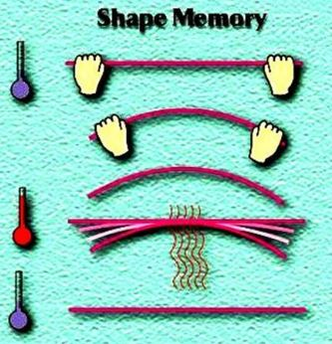
DEPARTMENT OF
CIVIL ENGINEERING
Course: Basics of Civil Engineering & Mechanics
Credits: 3:0:0

Slide 36
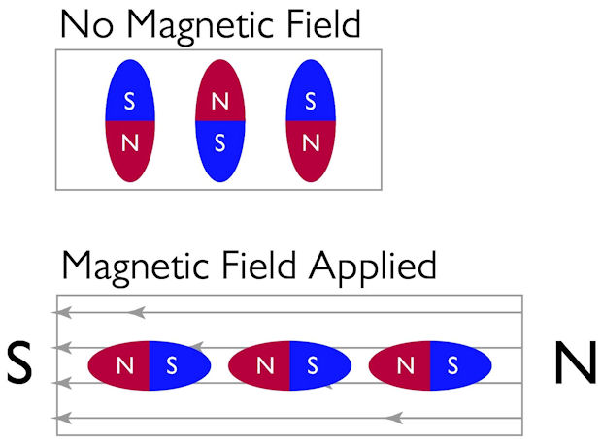
DEPARTMENT OF
CIVIL ENGINEERING
Course: Basics of Civil Engineering & Mechanics
Credits: 3:0:0
Magnetostrictive Materials
These materials undergo mechanical deformation in proportional to the square of the electric field, which refers to the material quality of changing size in response to either an electric or magnetic field, and conversely, producing a voltage when stretched. These materials show promise in applications ranging from pumps and valves, to aerospace wind tunnel.

Slide 37
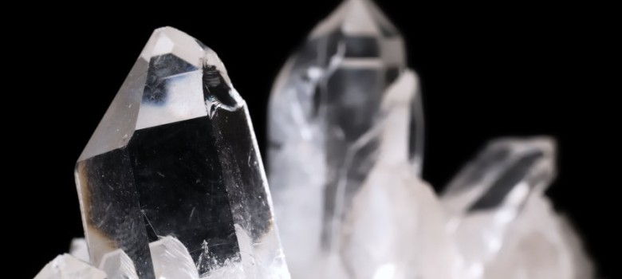
DEPARTMENT OF
CIVIL ENGINEERING
Course: Basics of Civil Engineering & Mechanics
Credits: 3:0:0
Piezoelectric materials
Piezoelectric materials are such smart materials that produce a voltage when stress is applied. Since this effect also applies in a reverse manner, a voltage across the sample will produce stress within sample. Suitably designed structures designed from these materials can, therefore, be constructed that bend, expand or contract when a voltage is applied making them adaptive to environmental situations. When integrated into a structural member, a piezoelectric material generates an electric field in response to mechanical forces.

Slide 38
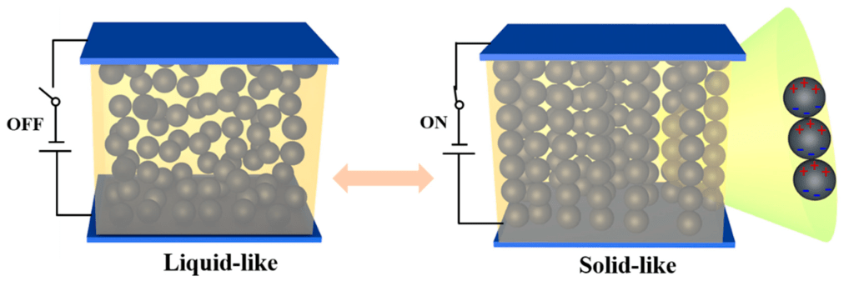
DEPARTMENT OF
CIVIL ENGINEERING
Course: Basics of Civil Engineering & Mechanics
Credits: 3:0:0
Electrorheological fluids
These colloidal suspensions undergo changes in viscosity when subjected to an electric field. Such fluids are highly sensitive and respond instantaneously to any change in the applied electric field. Civil engineers mostly find their application in shock absorbers.

Slide 39
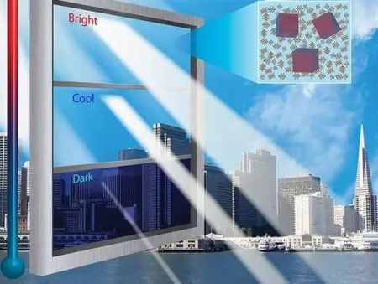
DEPARTMENT OF
CIVIL ENGINEERING
Course: Basics of Civil Engineering & Mechanics
Credits: 3:0:0
Electrochromic materials
These materials alter their light transmission properties when voltage is applied which makes them adaptive enough to maintain chromatic panels and similar structures.

Slide 40
DEPARTMENT OF
CIVIL ENGINEERING
Course: Basics of Civil Engineering & Mechanics
Credits: 3:0:0
Examples:
Synthetic spider web. This material is not only five times stronger than steel, but also has great elasticity. Its potential uses include: bulletproof clothing, artificial skin for burns or waterproof adhesives.
Shrilk. Its main component is chitin, a carbohydrate found in krill shells. It was created by researchers from Harvard University and is considered the ideal substitute for plastic — since its decomposition time is only two weeks and it also works as a stimulant for plant growth —.
Graphene. Its potential uses are almost unlimited: batteries with more autonomy, faster computers, flexible electronic devices, more resistant buildings, bionic limbs, etc. All this is possible thanks to their multiple properties

Slide 41
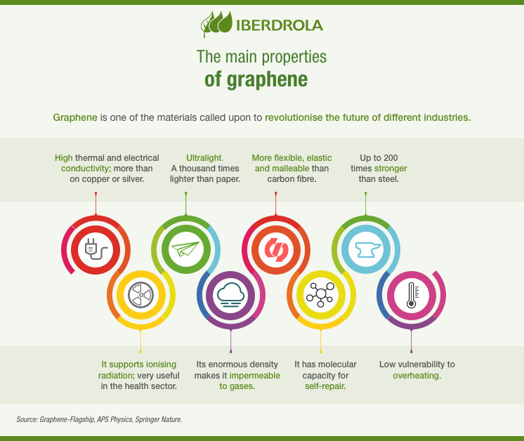
DEPARTMENT OF
CIVIL ENGINEERING
Course: Basics of Civil Engineering & Mechanics
Credits: 3:0:0

Slide 42
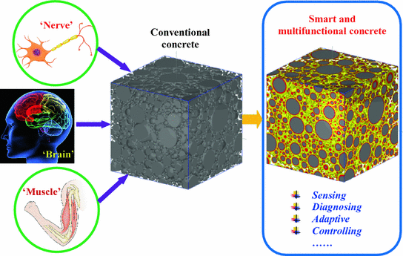
DEPARTMENT OF
CIVIL ENGINEERING
Course: Basics of Civil Engineering & Mechanics
Credits: 3:0:0
Smart concrete:(a composite of carbon fibres and concrete) used in smart structures is capable of sensing minute structural cracks / flaws.
Unlike conventional concrete, the smart concrete has higher potential and enhanced strength. It can be used in electromagnetic shielding and for enhanced electrical conductivity of concrete
Applications of Smart Materials in Construction

Slide 43
DEPARTMENT OF
CIVIL ENGINEERING
Course: Basics of Civil Engineering & Mechanics
Credits: 3:0:0
Smart concrete under loading and unloading process will loose and regain its conductivity, thus serving as a structural material as well as a sensor. Self-sensing concrete (also called self-monitoring concrete, intrinsically smart concrete, and piezo resistive or pressure-sensitive concrete) is fabricated by adding functional fillers (carbon fibers, steel fibers, carbon nanotubes, nickel powder, etc.) into conventional concrete to increase its ability to sense strain, stress, cracking, or damage in itself while maintaining or even improving mechanical properties.

Slide 44
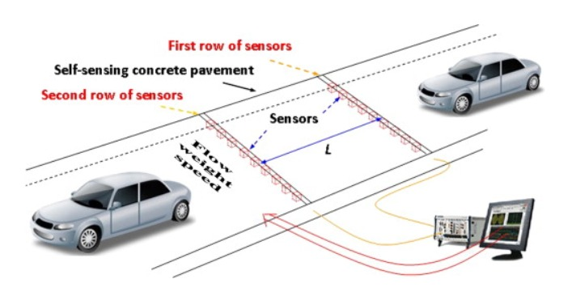
DEPARTMENT OF
CIVIL ENGINEERING
Course: Basics of Civil Engineering & Mechanics
Credits: 3:0:0
Application of smart concrete
Traffic Detection A vehicle detection sensor fabricated with self-sensing concrete has several advantages over conventional detectors, such as easy installation and maintenance, wide detection area, low cost, high anti-jamming ability, long service life, and good compatibility with pavement structures, because they are made of concrete materials.

Slide 45
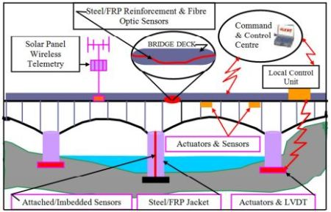
DEPARTMENT OF
CIVIL ENGINEERING
Course: Basics of Civil Engineering & Mechanics
Credits: 3:0:0
It can automatically warn on the re-opening of a crack or on the formation of new damage in a repaired portion of the structure.
Smart concrete can give us information of the strain level attained during an earthquake and on the potential lack for lateral confinement.

Slide 46
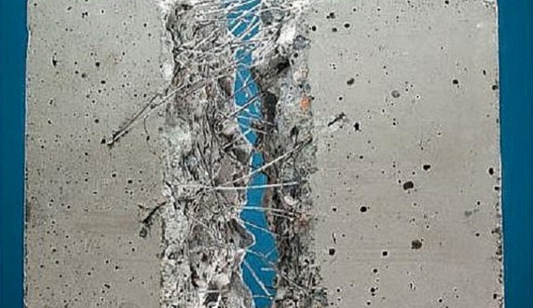
DEPARTMENT OF
CIVIL ENGINEERING
Course: Basics of Civil Engineering & Mechanics
Credits: 3:0:0
2)Fiber-reinforced concrete
Fiber Reinforced Concrete is a composite material consisting of fibrous material which increases its structural integrity. It includes mixtures of cement, mortar or concrete and discontinuous, discrete, uniformly dispersed suitable fibers. Fibers are usually used in concrete to control cracking due to plastic shrinkage and to drying shrinkage. They also reduce the permeability of concrete and thus reduce the bleeding of water.

Slide 47
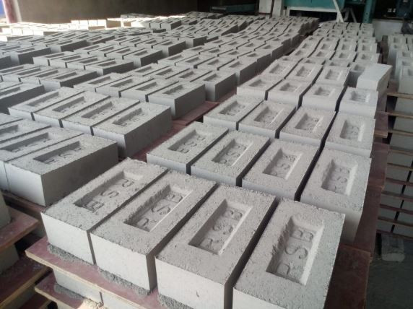
DEPARTMENT OF
CIVIL ENGINEERING
Course: Basics of Civil Engineering & Mechanics
Credits: 3:0:0
3)Fly Ash
Fly ash is a fine powder that is a byproduct of burning pulverized coal in electric generation power plants. Fly ash is a pozzolan, a substance containing aluminous and siliceous material that forms cement in the presence of water.
Fly ash can be used as prime material in many cement-based products, such as poured concrete, concrete block, and brick.
One of the most common uses of fly ash is in Portland cement concrete pavement or PCC pavement. Road construction projects using PCC can use a great deal of concrete, and substituting fly ash provides significant economic benefits.

Slide 48
DEPARTMENT OF
CIVIL ENGINEERING
Course: Basics of Civil Engineering & Mechanics
Credits: 3:0:0
Other uses of smart materials:
Smart materials have applications in the design of smart buildings. Smart materials are used for vibration control, noise mitigation, safety and performance.
In construction of smart buildings, for environmental control, structural health monitoring.
In smart building, it used to transform efficiency, comfort, and safety for people and assets.
Smart materials reduce the effects of earthquakes.
In marine and rail transport applications for strain monitoring using embedded fiber optic sensors.

Slide 49
DEPARTMENT OF
CIVIL ENGINEERING
Course: Basics of Civil Engineering & Mechanics
Credits: 3:0:0
The use of smart materials permits the construction of smart bridges especially cable stayed bridge with a wider span to avoid the increased susceptibility to vibrations caused by ambient factors such as wind, rain or traffic. Hence, the structure required less maintenance and the response of the structure can be monitored.
They are used to monitor the civil engineering structures to evaluate their durability.
Smart materials in structures used to monitor the integrity of bridges, dams, offshore oil-drilling towers where fiber-optic sensors embedded in the structures are utilized to identify the trouble areas.
They can be used to rehabilitate the cracking of concrete when super elasticity smart material is used as the reinforcement bar.

